Slide 1
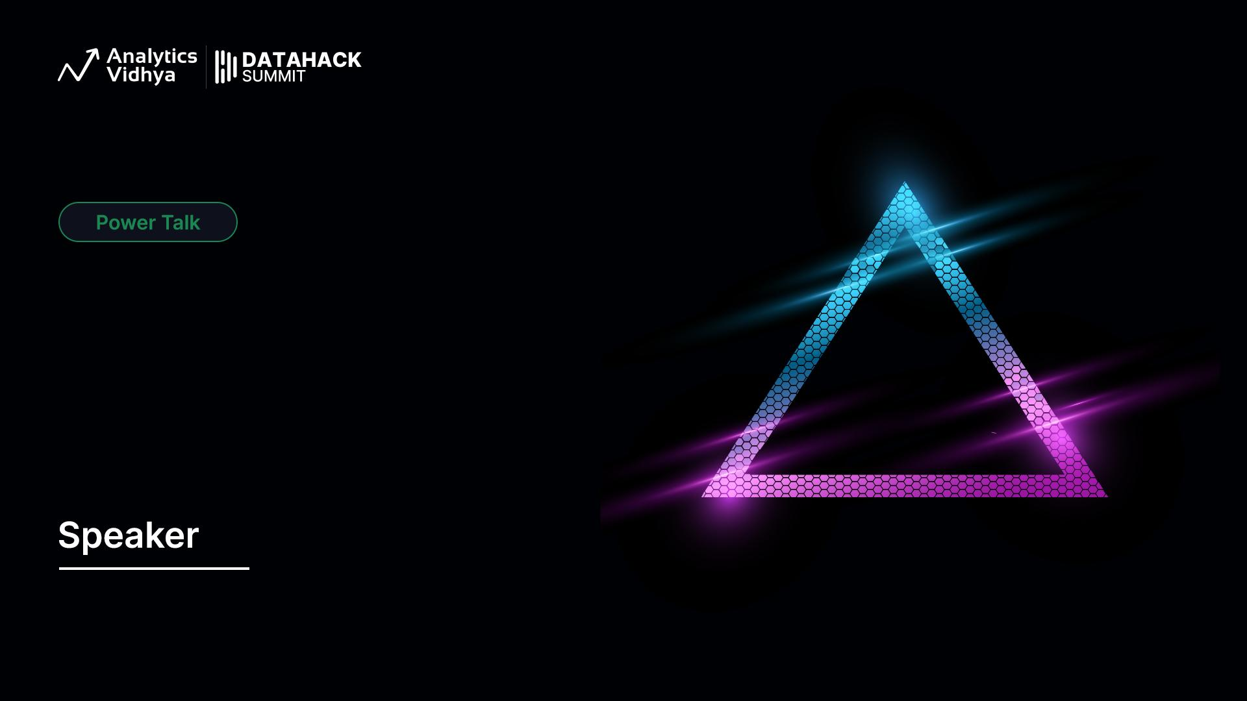
Zero to Million
How GenAI Agents are Changing Performance Marketing
Krishna Kumar Tiwari
Co-Founder & CTO Whilter AI

Slide 2
What is Performance Marketing?
Analyze Data & Optimize
Define your goals
Define your channel
Design Campaign
Execute Campaign
Performance marketing is advertising with a scoreboard. Every click, every lead, every sale is tracked, optimized, and accountable
📊 Measured → Every click tracked
🎯 Targeted → Right person, right time
⚡ Results-driven → Pay only for outcomes

Slide 3
Top Challenges in Performance Marketing
🎯 Relevance & Personalization
No Personalization – same message for everyone
Ad Fatigue – repetitive creatives reduce CTR by up to 50%
📊 Data & Measurement
Attribution confusion → 60% struggle with conversion drivers
Latency → ROI drop by 20%
💰Cost & Compliance
Cookie deprecation → 80% drop in tracking accuracy
Data overload → only 40% used effectively
CPC up 15–20% YoY
Cross-channel complexity → inconsistent messaging

Slide 4
🎯 Relevance & Personalization​ Layer Transformation
Pain (Zero)
Leap (GenAI + The Agentic Shift)
Outcome (Millions)

Slide 5

Pain = Zero
⏳Campaigns take weeks to plan & launch
🎨 Creatives are generic — same ad for everyone
📧 Personalization limited to just a name in an email
👥 Scaling = hiring more designers, copywriters, media buyers
This is the zero — where most brands are today. Limited personalization, high manual effort, slow speed.

Slide 6
Why GenAI Alone Doesn’t Scale
⚠️ Prompt = 1:1 Generation → Bottleneck
🧩 Templates don’t adapt to persona / context / moment
⚡ High Throughput → 100K+ / day
📱 Platform Fit → WhatsApp ≠ Instagram ≠ YouTube
🔄 Feedback Loops → ROAS / CTR optimization

Slide 7
Leap = 🧠(GenAI) + ⚡(The Agentic Shift)
GenAI is the Brain. Engineering is the Backbone. Agentics is the Nervous System. Agents are the Muscles that actually move.
🤖 CRM + LLMs
⚡Automation
Creatives adapt to context (weather, location, behavior)
Dynamic creative variations for each persona
One brief → hundreds of tailored assets instantly
🔄 Real-time Optimization

Slide 8
Outcome = Millions
📈 Higher CTR & Conversions
⚡ Faster Go-to-Market
💰 Cost Efficiency
🌍 Omnichannel Presence
Every ad feels “made for me.”
Days instead of weeks.
More output without proportional spend.
Own every micro-moment across channels.
That’s the million — millions of personalized, high-performing creatives, all generated and optimized in real time.

Slide 9
The New Reality
An AI-powered, agentic system can:
🎯 Create millions of unique creatives
👤 Be persona-aware & context-driven
📱 Adapt to each channel in real time
💡 Scale without scaling human teams

Slide 10
What Makes a System Agentic?
Autonomy
Planning
Memory
Feedback
Operates on goals, not instructions
Breaks goals into steps
Stores user & brand knowledge
Chooses APIs & generation paths
Adjusts via real-time performance signal
️ Tool Use
Agentic systems don’t just generate — they sense, plan, act, and learn.

Slide 11
LangGraph + vLLM + Redis + Cloud Functions + Retrieval
Observability & Guardrails: OpenTelemetry + Prometheus; PII/prompt-inject filters
Orchestrator: LangGraph – stateful, multi-agent flows
LLM Inference: vLLM (swap: Groq, Bedrock, Vertex)
Memory/State & Cache: Redis (KV + prompt/result cache)
Retrieval: pgvector/FAISS over brand/CRM/docs
Tools/Actions: Cloud Functions/Lambda (ad APIs, weather, geo, pricing, FFMPEG)
Queueing: SQS/Kafka/Redis Streams for 100K+/day throughput
Agentic systems don’t just generate — they sense, plan, act, and learn.

Slide 12
The Power Trio Behind Modern Marketing AI
GenAI = The Brain
Generates ideas, content, and intelligence.
🦴 Engineering = The Backbone
Provides infra, scale, and reliability.
⚡ Agentics = The Nervous System
Orchestrates decisions & actions in real time.
​
Together, they power modern, scalable, adaptive marketing.

Slide 13
Agentic Marketing Engine
Input Layer
Orchestrator (Center Hub)
Output Layer
Campaign Brief
📝 Scripting Agent
🎨 Design Agent
🖼️ Asset Generator
🎭 Actor Generator
📱 Channel Agents
Research Agent
Millions of Creatives
CRM / Audience Data
Agent Orchestrator
Distributed
📱 WhatsApp
📸 Instagram
▶️ YouTube
📺 OTT
✉️ Email
Planner
CTR, ROAS, Conversions
Cloud Functions/Tools Layer (Text2Image, TTS,VC, LS, Image Model, Video Models, Avtar)
Feedback Layer

Slide 14
The Orchestrator – How to Build One
Feedback Loop → performance metrics → retraining / prompts
Core Responsibilities
Interpret campaign goals → convert to tasks
Delegate tasks to Planner & Agents
Manage state, memory, and retries
Handle failures & feedback
Tech Building Blocks
LangGraph / AutoGen / CrewAI → Agent workflow framework
vLLM → Efficient LLM inference (low latency, scalable)
Redis / Postgres → State & memory storage
Cloud Functions / Kubernetes → Event-driven task execution
API Integrations → CRM, Ad Channels, Analytics
Execution Flow
Receive Input (campaign brief, audience data)
Planner decomposes → (script, design, assets, channel mapping)
Agents execute tasks in parallel / sequence
Output → creatives + distribution APIs

Slide 15
Asset Generator Agent (Technical View)
Engagement metrics (CTR, watch time, shares) → Auto fine-tuning
Inputs:
Script (from Scripting Agent)
Brand Guidelines (color, logo, tone)
Persona Data (from CRM/Audience Layer)
Prompt Compiler → merges script + persona + style tokens
Model Router → chooses best model (Sora, Veo, Runway, SDXL, internal models)
Customization Layer → LoRAs, ControlNets, inpainting, background swap
Post-processing → Quality filter, watermark/logo injection
Personalized videos/images
Format variants (16:9, 9:16, etc.)
Multi-lingual/localized assets
Processing Stack (inside the Agent):
Outputs:
Feedback Loop:

Slide 16
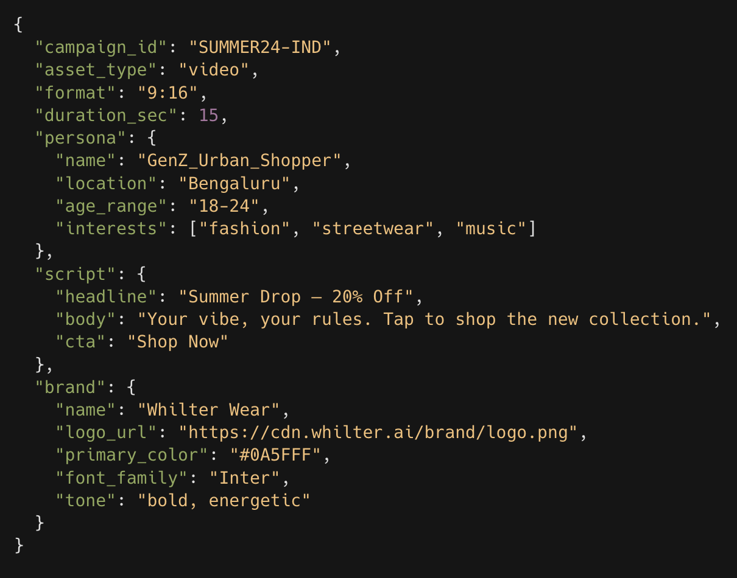
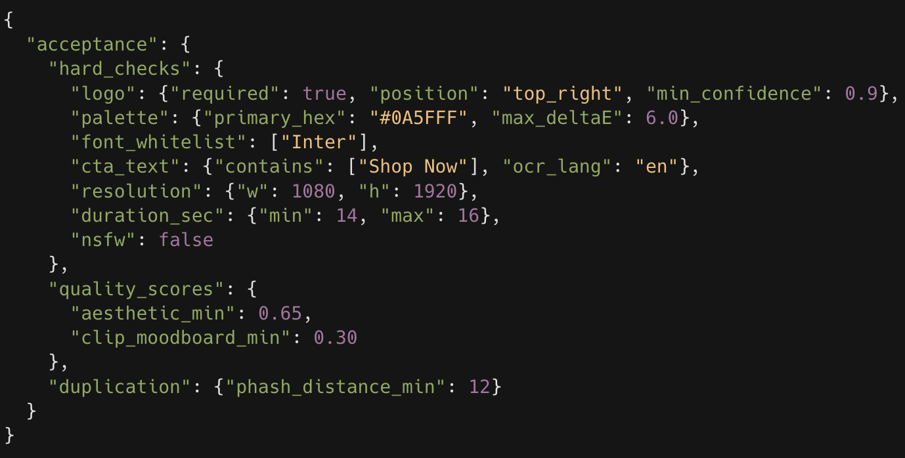
Asset Generator Agent (Inside View)
Input | Campaign Spec
Acceptance Spec

Slide 17
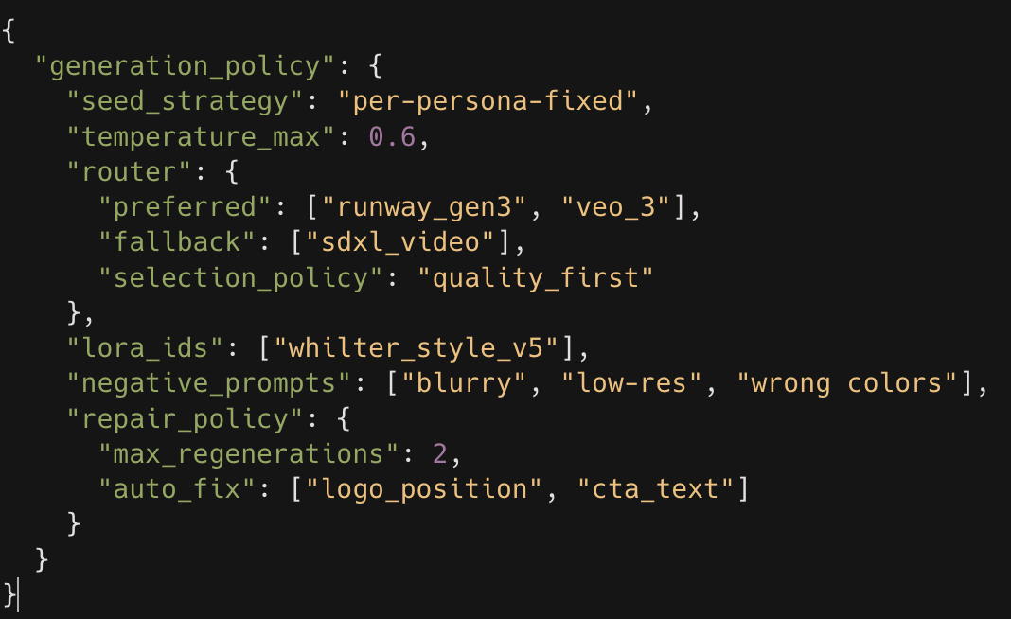
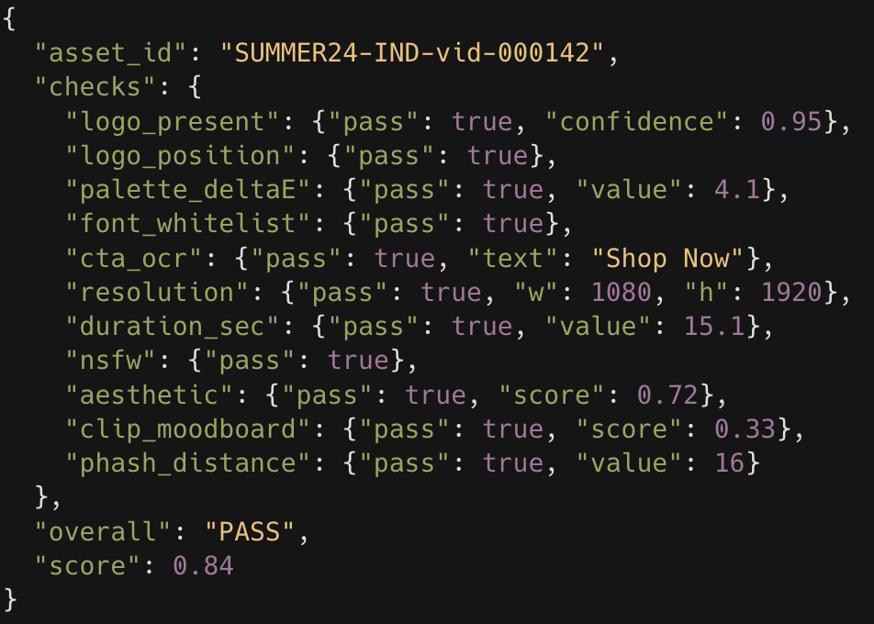
Asset Generator Agent (Inside View)
Generation Policy
Validation Report

Slide 18
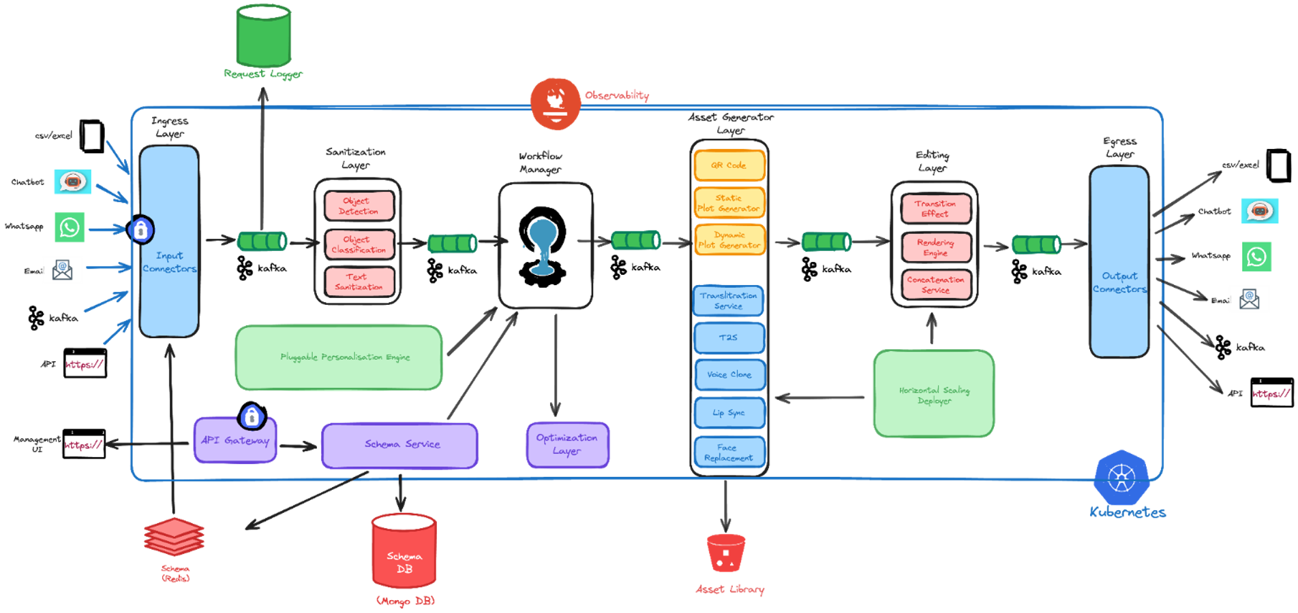
Engineering → The Backbone

Slide 19
Engineering Challenges & Scaling Strategy
Challenge | Possible Solution
Latency | vLLM / quantized models, GPU batching, Redis caching
Data Volume | Horizontal scaling (K8s pods), async queues (Kafka/SQS), sharded DBs
Cost Efficiency | Spot GPUs, autoscaling, model router (cheap vs. premium models)
Orchestration Complexity | LangGraph / workflow engines, event-driven pipelines with retries
Compliance & Safety | Guardrail microservices, HITL fallback, content moderation APIs
Attribution Integration | Event pipelines (Kafka → DB), feedback loops into fine-tuning & prompts

Slide 20
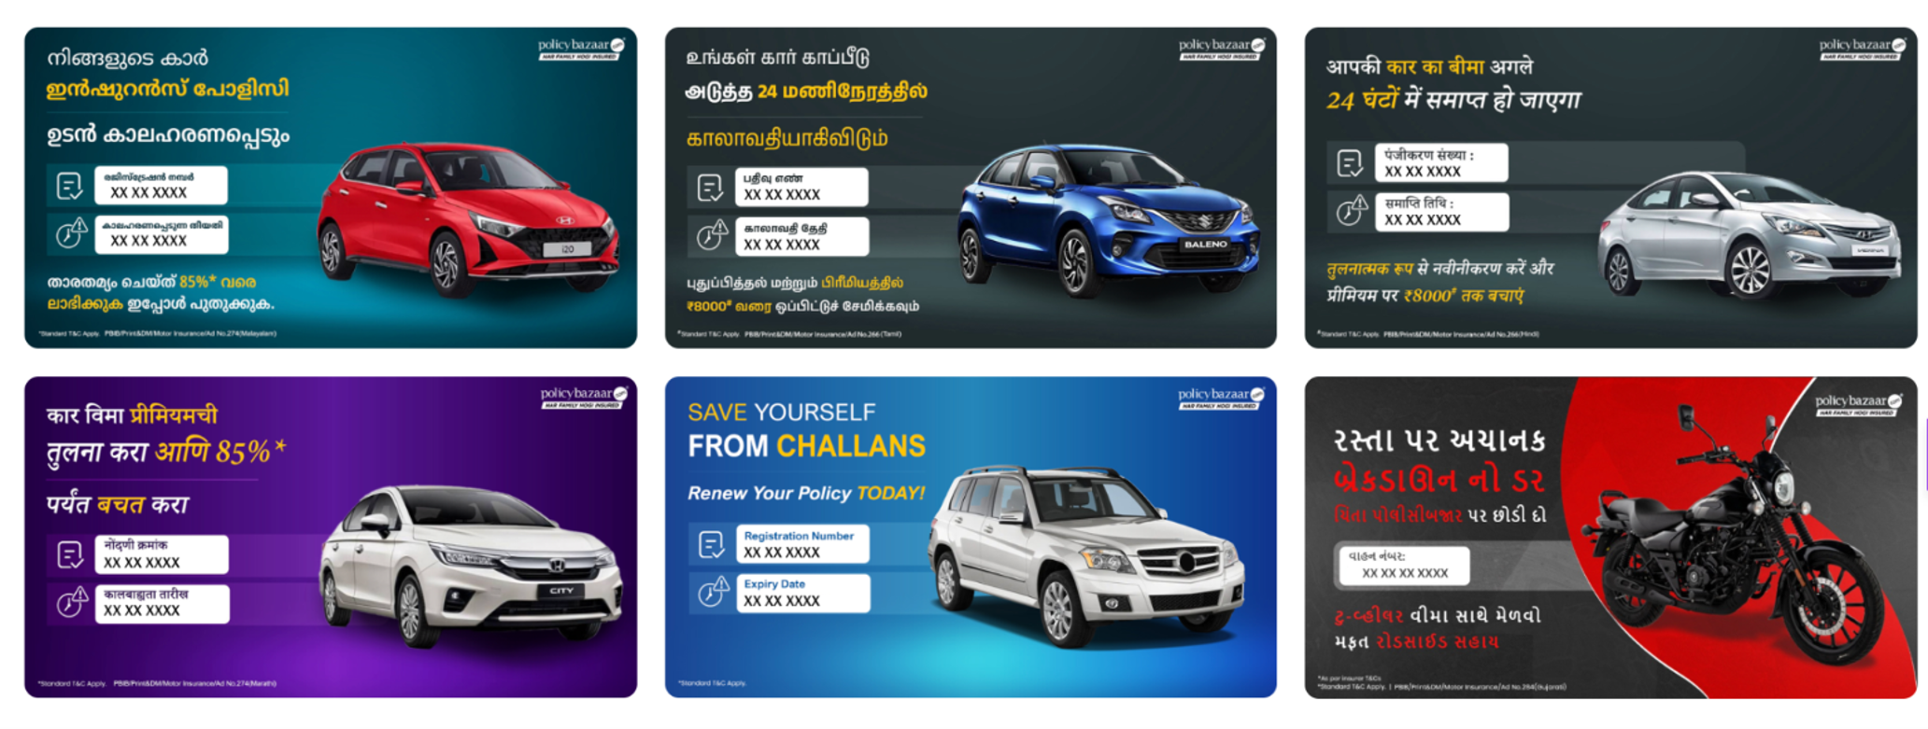
Case Studies | Policy Bazar X Whilter AI
Re-engage customers before policy lapse — across 7 languages and multiple insurance products
40M creatives delivered
40% CTR uplift
10% increase in renewals

Slide 21
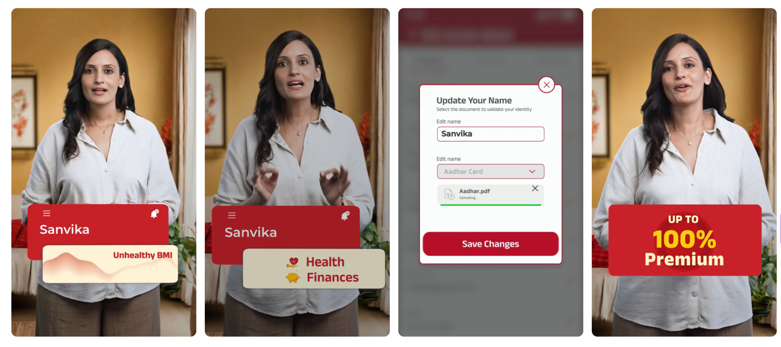
Case Studies | Aditya Birla Health Insurance
44% Conversions Upliftment
10X Lift in Same-Day Registrations
Enhanced Customer Engagement
Hyper-Personalized Videos – Your Health, Your Story, Powered by AI!

Slide 22
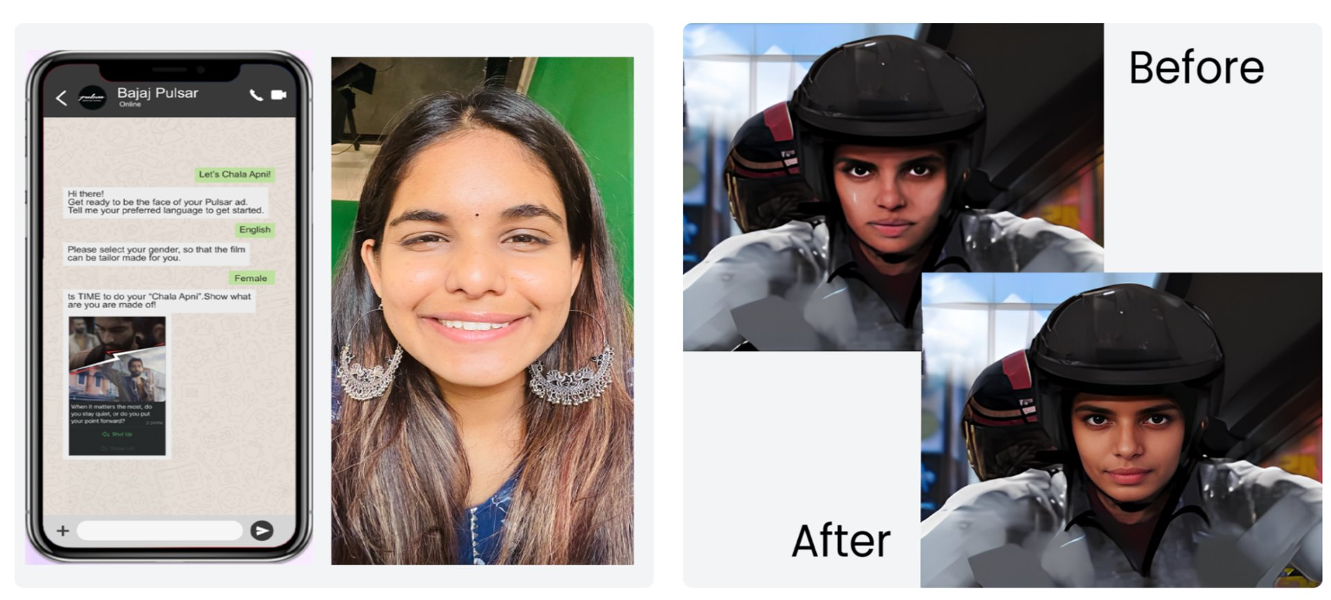
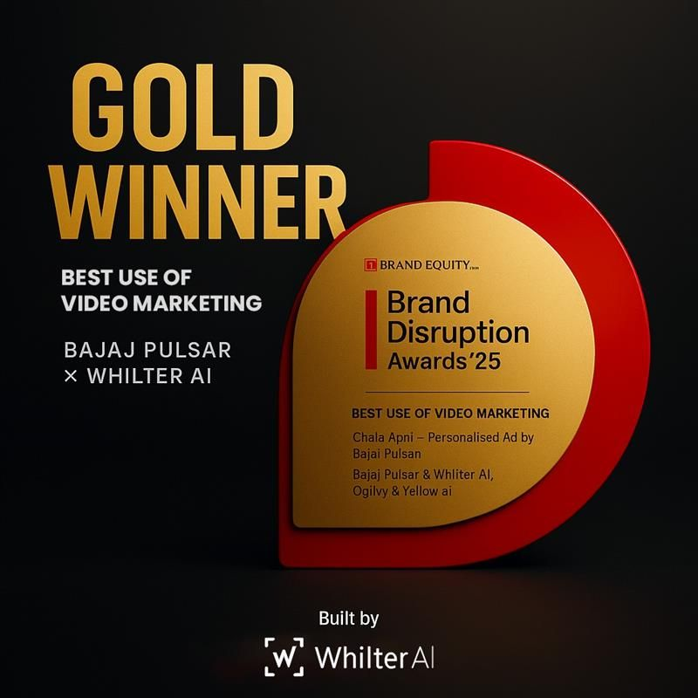
Case Studies | Bajaj X Whilter AI
Enter "Chala Apni" – One Selfie, Infinite Stardom!

Slide 23
Final Takeaways
Features
Systems
Autonomy
Don’t just build GenAI features — build systems that act
Think in orchestration layers, not just prompts
Build in control, feedback, and adaptability
This is not marketing automation. This is autonomous marketing engineering

Slide 24


